Slide 1



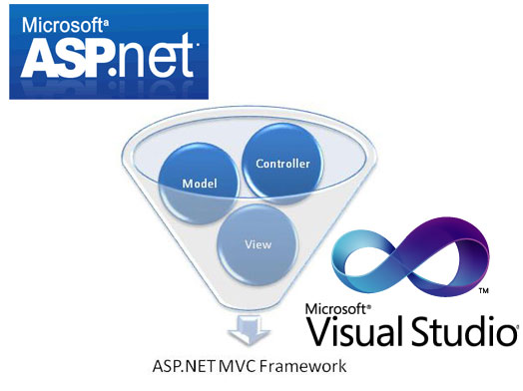

ASP.NET MVC Essentials
Routing, Controllers, Actions, Views, Areas…
SoftUni Team
Technical Trainers
Software University
http://softuni.bg

Slide 2

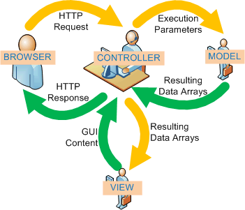
Table of Contents
Scaffolding
Model Binders
Editor & Display Templates
Data Validation
Session, TempData
Working with Data Source
Repository Pattern
Unit of Work Pattern
Ninject IoC and AutoMapper

Slide 3
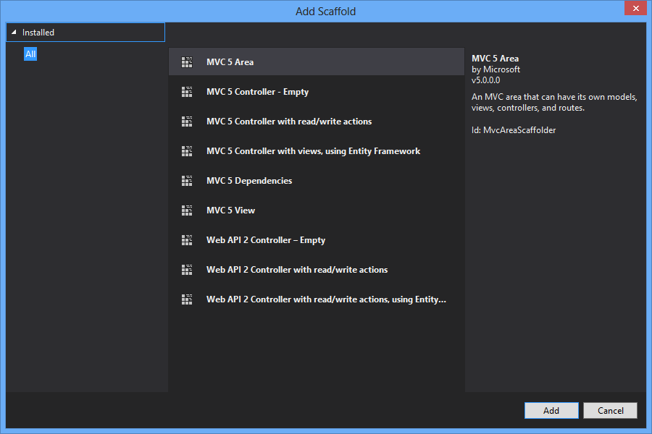
Scaffolding

Slide 4
What is ASP.NET Scaffolding?
Code generation framework for ASP.NET
When you want to quickly add boilerplate code that interacts with data models
Developer productivity enhancer
Can reduce the amount of time to develop standard data operations in your project
Enables customization
Provides an extensibility mechanism to customize generated code
VS 2013 includes pre-installed code generators for MVC, and Web API

Slide 5
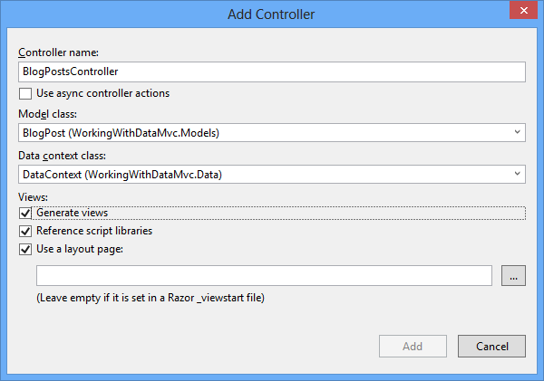
Demo: Create Scaffold
Create CRUD pages with read/write actions, using Entity Framework

Slide 6

Model Binders

Slide 7
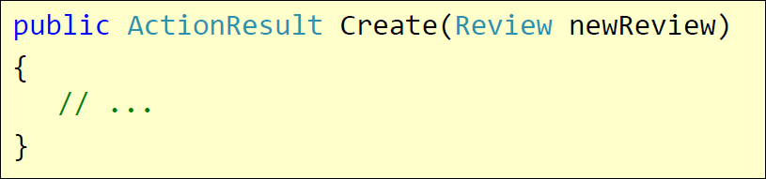
Model Binders
To make easy of handling HTTP post request
Help the populating the parameters in action methods
DefaultModelBinder
HTTP POST /Review/Create
Rating=7&Body=Great!

Slide 8

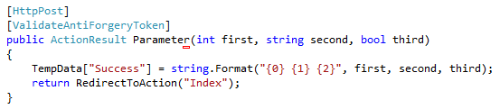
Model Binders
Parameter binding
The name attribute of the input HTML element should be the same as the name of parameter in the action

Slide 9
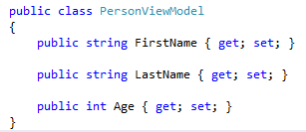

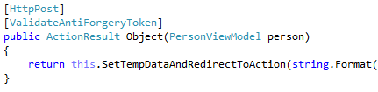
Model Binders
Object binding
Model binder will try to "construct" the object based on the name attributes on the input HTML elements

Slide 10

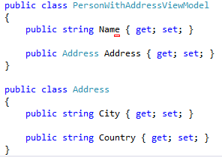
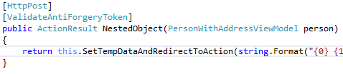
Model Binders
Nested Objects binding
Use name attributes as following "{obj}.{nestedObj}" or use EditorFor

Slide 11


Model Binders
Collection of primitive types binding
Use the same name attribute on every input element and the parameter name of the collection in the action (you can use loops)

Slide 12
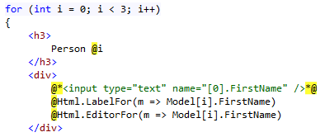
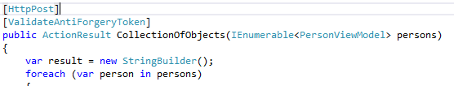
Model Binders
Collection of objects binding
Use name attributes like "[{index}].{property}" or use EditorFor in a for loop

Slide 13

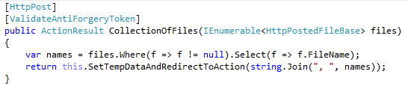
Model Binders
Collection of files binding
Use the same name attribute on all input type files as the name of the collection

Slide 14
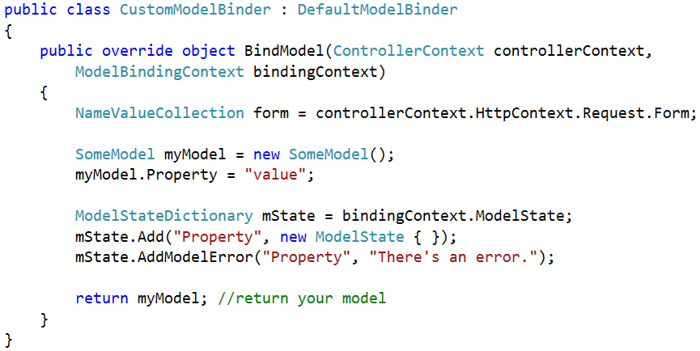
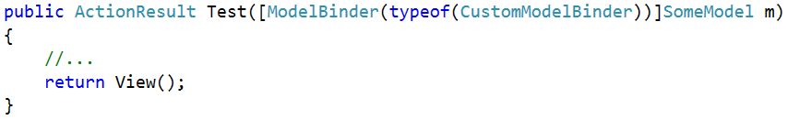
Custom Model Binder

Slide 15

Display & Editor Templates

Slide 16

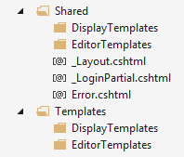
Templates
ASP.NET MVC comes with helpers methods
DisplayFor(), DisplayForModel()
EditorFor(), EditorForModel()
There are default implementation
Easily to be configured
Create folders "DisplayTemplates" and "EditorTemplates" in the "Shared" folder or in the "Views/{Controller}" folder

Slide 17
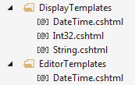
Custom Templates
In the two new folders create a view for each type you want
string -> String.cshtml
int -> Int32.cshtml
DateTime -> DateTime.cshtml
Student -> Student.cshtml
The name of the files must reflect the data types and the @model in them

Slide 18

Custom Templates
These view are normal view files
The framework will start using them instead of the default implementations
For example in the String.cshtml
Now all strings will be in paragraph element and will have quotes surrounding them
DisplayFor, EditorFor -> for properties
DisplayForModel, EditorForModel -> for model

Slide 19

Custom Templates
Passing additional information to the templates
There is an object "additionalViewData" in the helper methods as parameter
You can pass anything there as anonymous type
And get the values from the ViewData/ViewBag

Slide 20

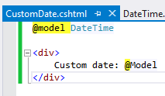
Custom Template Name
Sometimes you need two templates for one data type
Create the template with custom name
Decorate the property in the model with the UIHint attribute specifying the template name
You can set the name in the helpers too

Slide 21

Data Validation

Slide 22
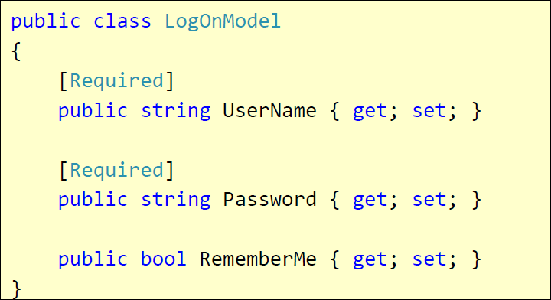
Validation with Annotations
Attributes are defined in
System.ComponentModel.DataAnnotations
Covers common validation patterns
Required
StringLength
Regex
Range

Slide 23
Data Validation Attributes
Attribute | Description
Compare | Checks whether two specified properties in the model have the same value.
CustomValidation | Checks the value against the specified custom function.
EnumDataType | Checks whether the value can be matched to any of the values in the specified enumerated type.
Range | Checks whether the value falls in the specified range. It defaults to numbers, but it can be configured to consider a range of dates, too.
RegularExpression | Checks whether the value matches the specified expression.
Remote | Makes an Ajax call to the server, and checks whether the value is acceptable.
Required | Checks whether a non-null value is assigned to the property. It can be configured to fail if an empty string is assigned.
StringLength | Checks whether the string is longer than the specified value.

Slide 24
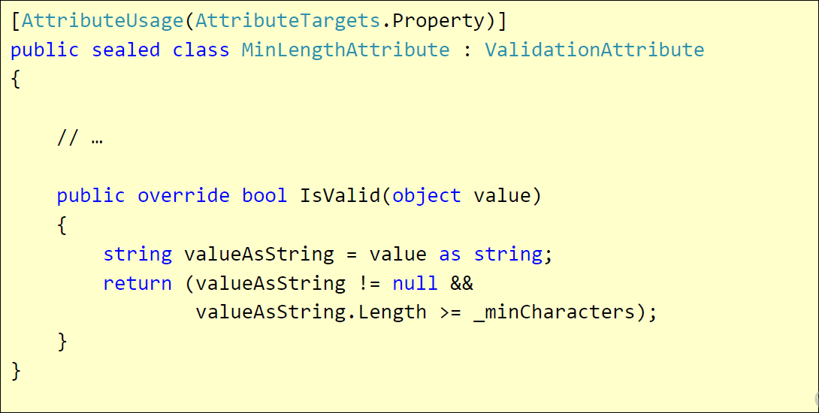
Custom Validation
Custom attributes
Inherit ValidationAttribute

Slide 25
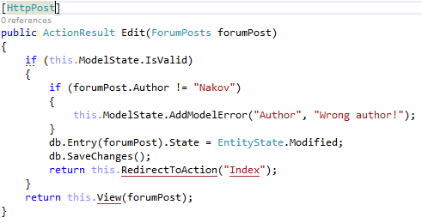
Validating Model – Controller
ModelState.IsValid – will give us information about the data validation success
ModelState.AddModelError – custom error

Slide 26
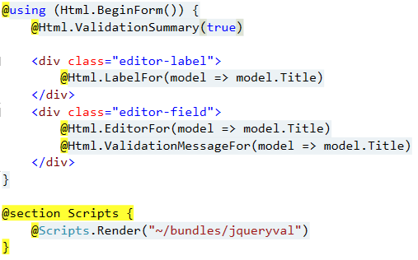
Validating Model – View
@Html.ValidationSummary – output errors
@Html.ValidationMessageFor(…) – outputs validation message for specified property
Text box with integrated client-side validation
jQuery validation library required for unobtrusive JavaScript validation
P.S. Check web.config

Slide 27
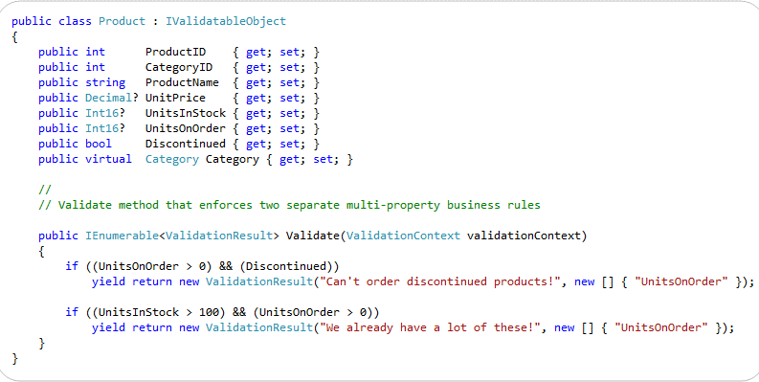
Class-Level Model Validation
Your model should implemented IValidatableObject
From now on, MVC (works with EF too) will validate the object by your custom rules

Slide 28
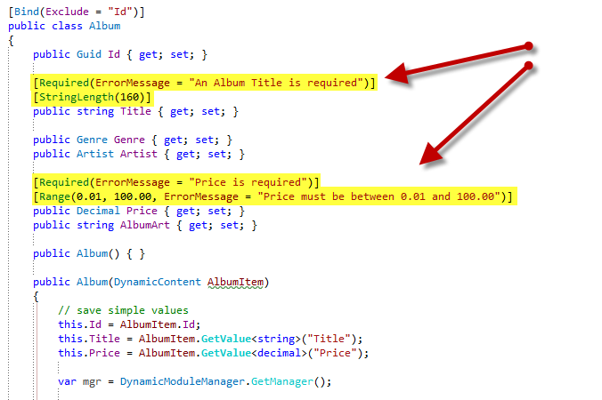
Other Annotations

Slide 29
Display / Edit Annotations
Attribute | Description
DisplayColumn | Specify the property of a model class for simple text display.
HiddenInput | Render value in a hidden input (when editing).
UIHint | Specify the name of the template to use for rendering.
DataType | Common templates (email, password, URL, currency)
ReadOnly | Specify a read-only property (for model binding).
DisplayFormat | Format strings and null display text
ScaffoldColumn | Turn off display and edit capabilities
DisplayName | Friendly name for labels
Bind | Tells the model binder which properties to include/exclude

Slide 30

Session, TempData, Cache

Slide 31
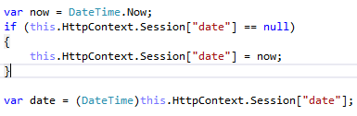
Session
Each client has session id, which ASP.NET stores
You can use it to store information in the memory of the application

Slide 32
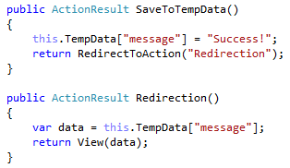
TempData
TempData can be used like a dictionary
Each saved value lasts for the current and the next request
Perfect for redirects

Slide 33
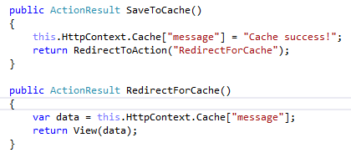
Cache
You can save global data into the Cache
It works like dictionary
It is not per client, but rather global

Slide 34

Working with Data Source
Repository pattern and Unit of Work pattern

Slide 35
Repository Pattern
Separate business code from data access
Separation of concerns
Testability
Encapsulate data access
Increased level of abstraction
More classes, less duplicated code
Maintainability, Flexibility, Testability
Generic repositories
IRepository<T>

Slide 36
Repository Pattern (2)
Business & Domain Logic
Exchange Rates Repository
Blog Posts Repository
Settings Repository
Web Service
SQL Database
File

Slide 37
Unit of Work
Track changes in persistent objects
Efficient data access
Manage concurrency problems
Manage transactions
Keep business logic free of data access code
Keep business logic free from tracking changes
Allow business logic to work with logical transactions

Slide 38
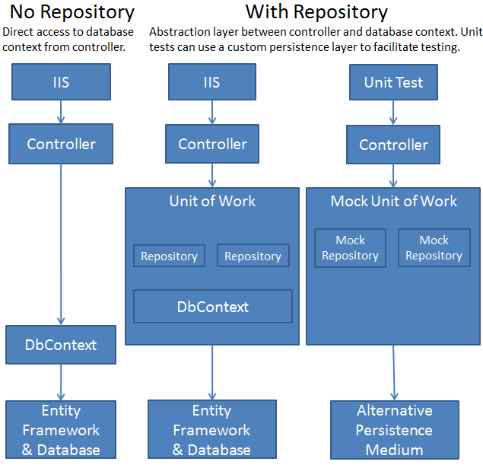
Repository and UoW Patterns in an ASP.NET MVC

Slide 39

Ninject IoC
You may want to use IoC for dependency inversion
Ninject is quite easy to do
Install Ninject.MVC5 from NuGet
In App_Data/NinjectWebCommon add your bindings in RegisterServices method

Slide 40
AutoMapper
You may want to use AutoMapper to map your database models to ViewModels for the web
Install AutoMapper from NuGet
Make mappings for the models
Use them in your LINQ queries
Check the documentation
http://automapper.org/

Slide 41









ASP.NET MVC
https://softuni.bg/courses/asp-net-mvc/

Slide 42
License
This course (slides, examples, demos, videos, homework, etc.) is licensed under the "Creative Commons Attribution-NonCommercial-ShareAlike 4.0 International" license
Attribution: this work may contain portions from
"ASP.NET MVC" course by Telerik Academy under CC-BY-NC-SA license

Slide 43





Free Trainings @ Software University
Software University Foundation – softuni.org
Software University – High-Quality Education, Profession and Job for Software Developers
softuni.bg
Software University @ Facebook
facebook.com/SoftwareUniversity
Software University @ YouTube
youtube.com/SoftwareUniversity
Software University Forums – forum.softuni.bg

